Slide 1

ALL-IN-ONE System
GHYPER SERIES
Product training
2021.11

Slide 2
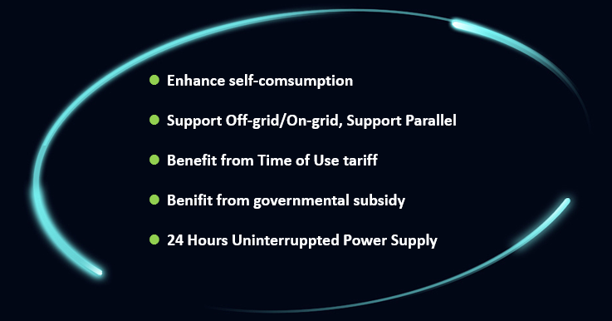
Why choose ALL-IN-ONE System

Slide 3
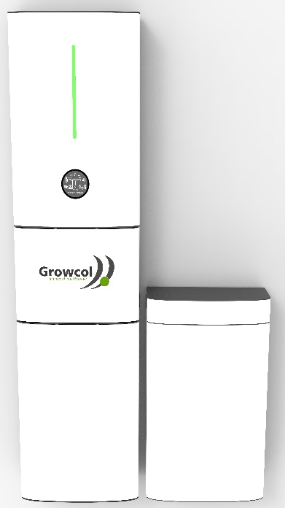
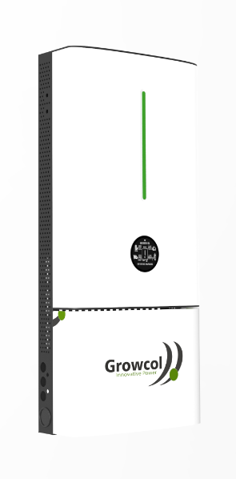


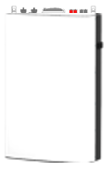
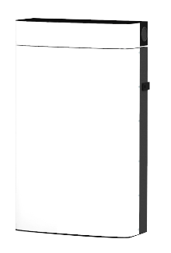
Key Features
01
IP21 protection class
04
Die-cast aluminum case
07
Integrated PV&AC Breakers &SPD
02
Home appliance design
05
Natural cooling, low noisy
08
Remote configuration & upgrade
03
UPS function
06
Battery parallel to 5
+
+
Battery
(All-in-one Application)
Battery
(Expansion Application)
Ghybrid inverter
All-in-one system
All-in-one system

Slide 4
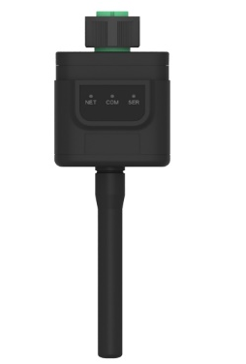
Communication Accessory
01
Plug and play, no extra power supply is required
02
Independent module, protecting internal parts of inverter
03
External indicator lights, ensuring collection status at a glance
breakpoints retransmit.
04
Waterproof design, resistant to bad weather
Wi-Fi Stick
for GHybrid Inverter
breakpoints retransmit.
05
External design, easy to replace faulty equipment
Notes:
外置指示灯设计，采集状态一目了然
即插即用，逆变器内部取电，无需外接电源，安装更随心
独立模块，保护逆变器内部零件，杜绝隐患
防水设计，抵御恶劣环境，提高设备稳定性
外置设计，更换故障设备更轻松

Slide 5
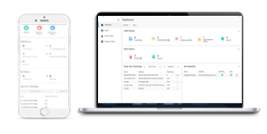

Monitoring System
Schedule your energy usage and storage.
Track real-time yield and consumption of your houses.
User-friendly graphs and automatic report generation.
Check system's conditions and communication status anytime anywhere.
Business Access
Global GIS and weather services.
Visualized Big-screen Display
Intelligent and Intuitive Alerts
Data Processing, offering efficient applications.
Remote control and upgrade devices, reduce your O&M costs.

Slide 6
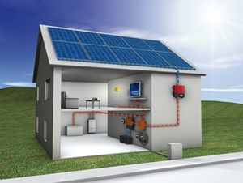

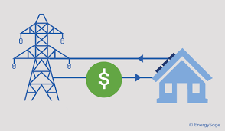

Working Mode
Self-Consumption Back-up Power Off-Grid
X

Slide 7
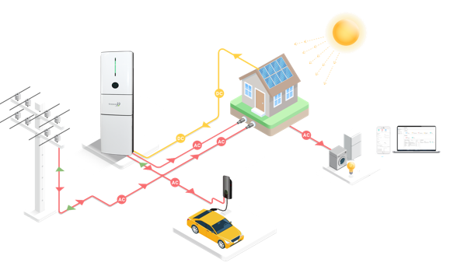

Application Scenario (With Grid)
Morning weak sunshine, PV + Grid Supply Loads;
Midday strong sunshine, PV supply load, surplus feed-in grid;
Afternoon weak sunshine, PV+battery/ Battery supply loads;
Night with high consumption, battery supply loads, Grid back up;
Notes:
Daytime with sunshine, PV charges battery; PV+Battery supply loads,
Nighttime without sunshine, battery supply loads.

Slide 8
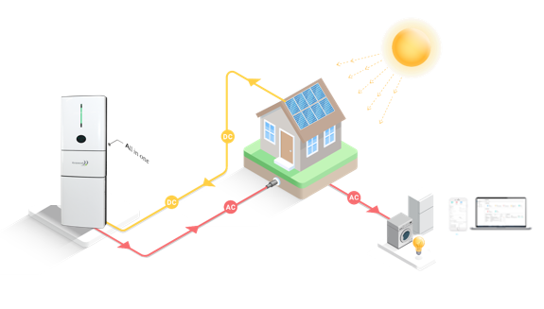


Application Scenario (W/O Grid)
Daytime with sunshine, PV charges battery; PV+Battery supply loads
Night without sunshine, battery supply loads.

Slide 9
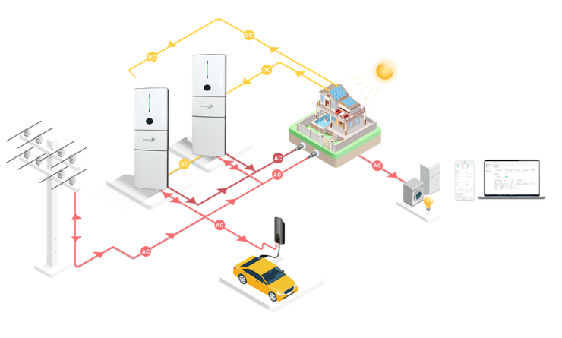
Application Scenario (Parallel)
Parallel Function
Max Power：10kW
Max Battery：25kwh

Slide 10
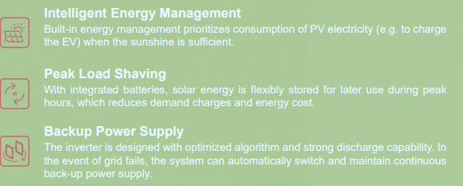
Name Rules for Inverter
Model
GHyper-3000 GHyper-3680 GHyper-5000
GHyper-5000
Power Rate
GHybrid Power
GCA Series Low Voltage Solar Hybrid Inverters

Slide 11
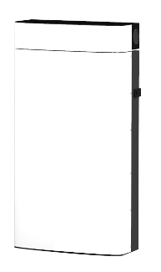
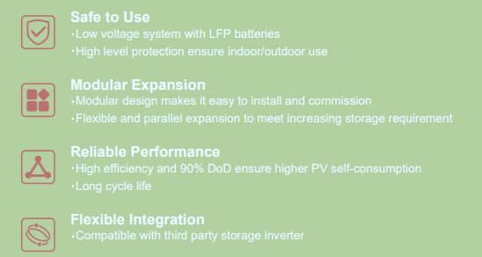
Name Rules for Battery
Model: GBLF51-5
or
GBLF51 - 5
GCL Series Li-ion battery
5kWh
B：Battery
L：Li-ion
F: LFP
51：51V

Slide 12

ALL-IN-ONE System Advantage-1
Reasons cause to battery dead
rainy days, the battery cannot be effectively charged
Active equilibrium
Reduce barrel effect
Active awake battery
PV array in fault situation, battery cannot be effectively charged
Improper use may cause the battery to be over-discharged and depleted.
cells
BMS
When the system turned off in a long time, battery discharged
Battery module

Slide 13
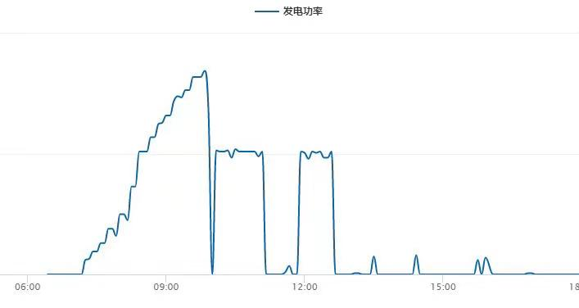
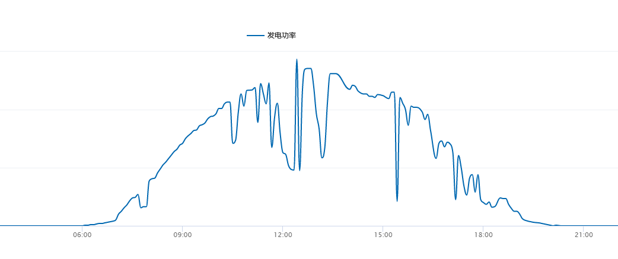
ALL-IN-ONE System Advantage-2
Improved MPPT performance in off-grid mode
Other inverter
GHybrid Inverter
Track every few minutes
Shut down when illumination fluctuates sharply
Track in real time
Respond quickly when illumination fluctuates sharply

Slide 14


ALL-IN-ONE System Advantage-3
Superior load capacity
Due to the optimized algorithm and high-power battery discharge capacity, the load capacity of the system in off-grid mode is greatly improved.
Load capacity
5kW AIO
AC1.5P
Kettle
Refrigerator
Desktop* 2
PC* 1
Microwave oven
LED light * 10
Battery
Confidential

Slide 15

ALL-IN-ONE System Advantage-4
EMERGENCY POWER SUPPLY Never Lose Power
With the Ghybrid you can ensure that you never go without power, even during a power-cut. An emergency power supply enables the ALL-IN-ONE to work completely off-grid, meaning that any power you have stored on your batteries will now be used in the event of a power cut. And the switch time is UPS in 10-15ms

Slide 16
Quick Installation Guide for AIO System

Slide 17
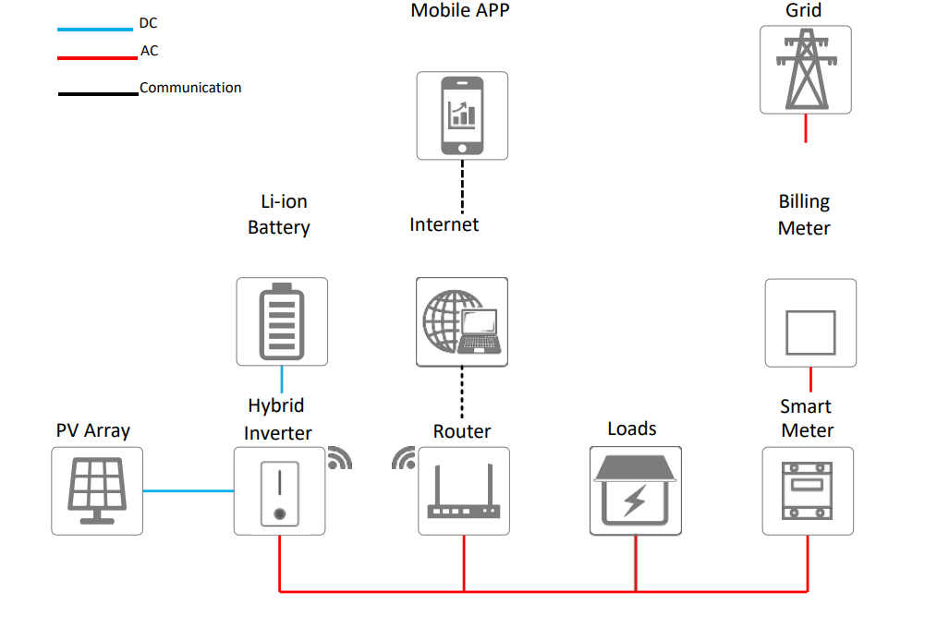
System Diagram

Slide 18
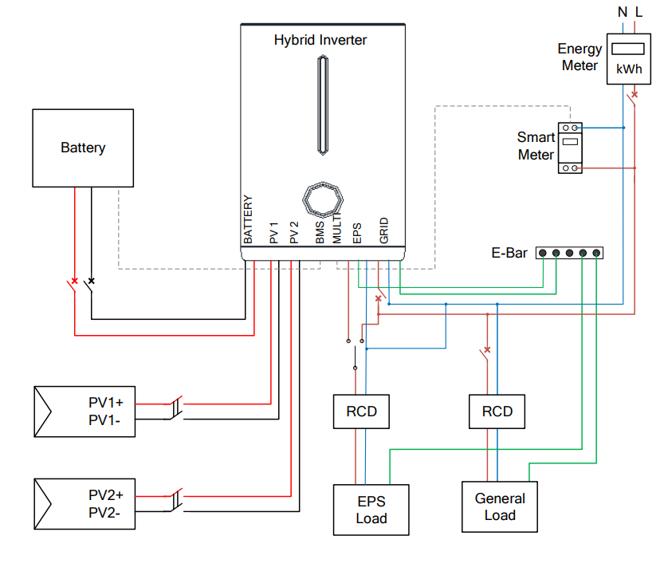
Wiring Diagram
Notes：
1.It is not recommended to short the N line and PE line at the customer's distribution box；
2.It is not recommended to short the EPS output N line with the grid N line；
3. If the customer needs the above two connection methods on site, some hardware versions of the inverter are not supported, please consult technical support personnel.
4. Choose a larger size for the Grid circuit breaker. For example, a 32A AC breaker is recommended for a 5KW inverter.

Slide 19
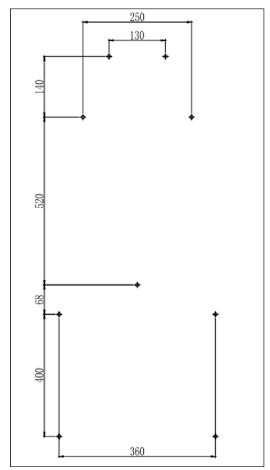
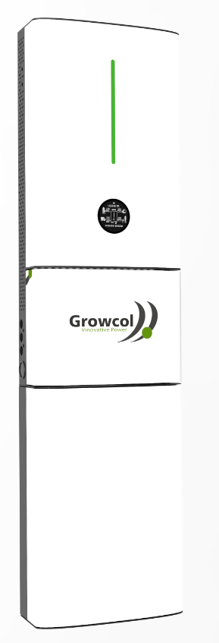
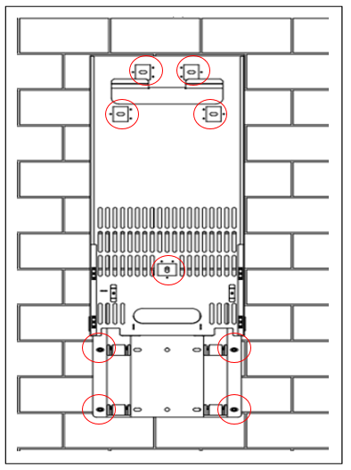
Location of Mounting
Be sure to choose a wall capable of supporting the full weight of the system.
Be sure to choose a flat wall.
The height of the holes from the ground must be ≥ 400mm
Drill holes with driller(Drill bit: φ12), make sure the holes are deep enough (at least 65mm)
415*1521*145mm
80KG
Brackets Holes
Dimensions

Slide 20
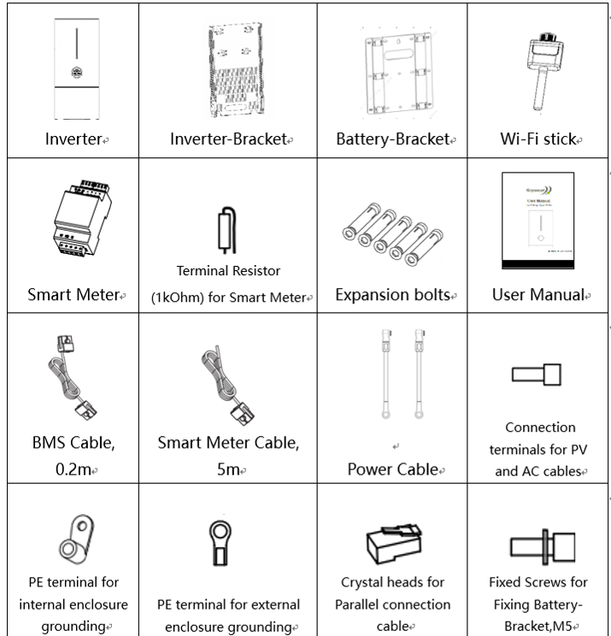
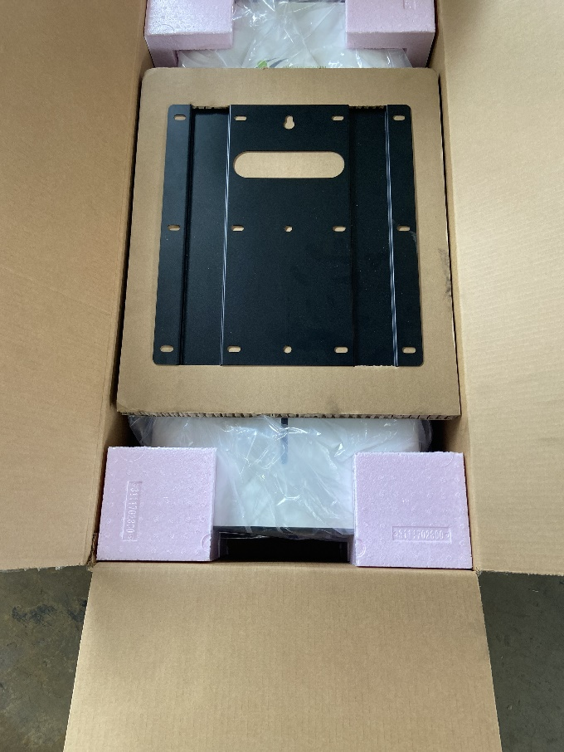
Packing List for Inverter
Inverter Package

Slide 21
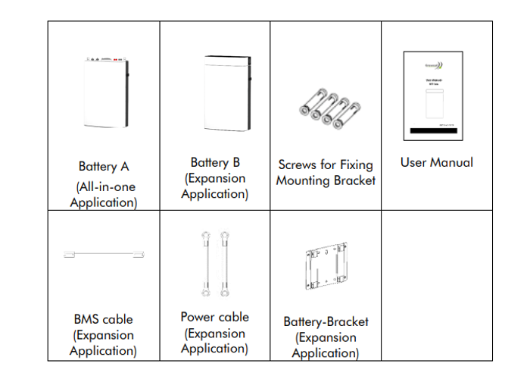


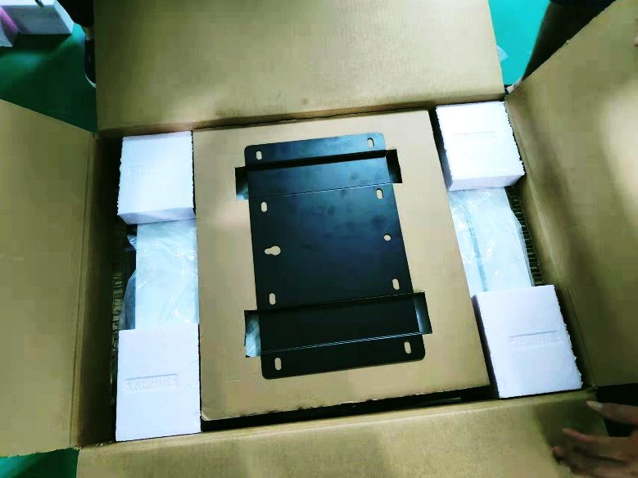
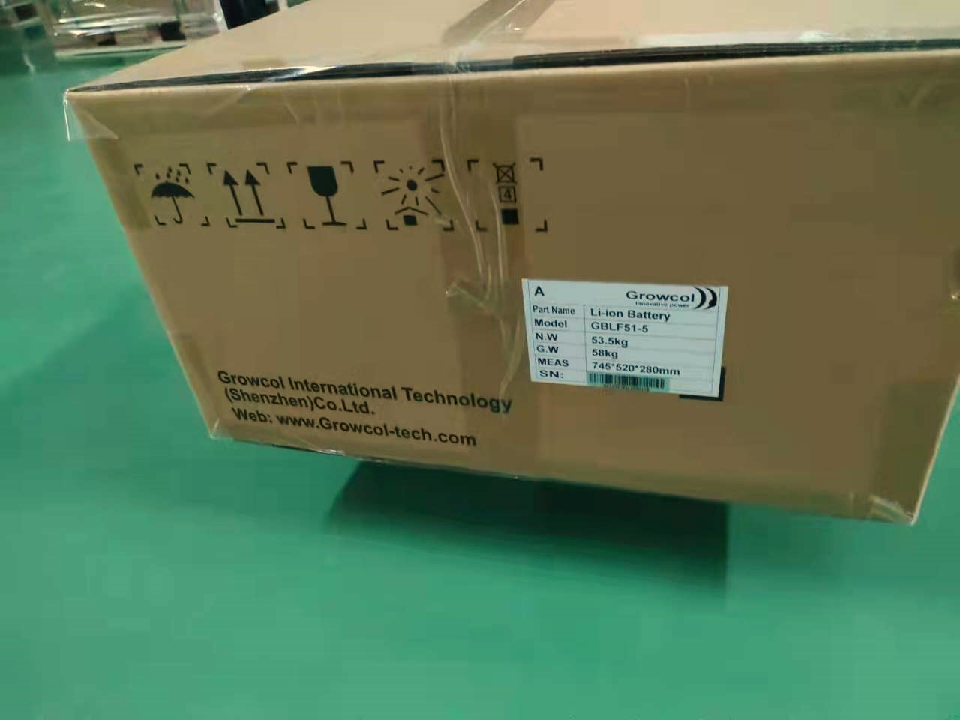
Packing List for Battery
Battery B Package
Battery A and Battery B are distinguished by "A" and "S" which marked on the outer carton

Slide 22
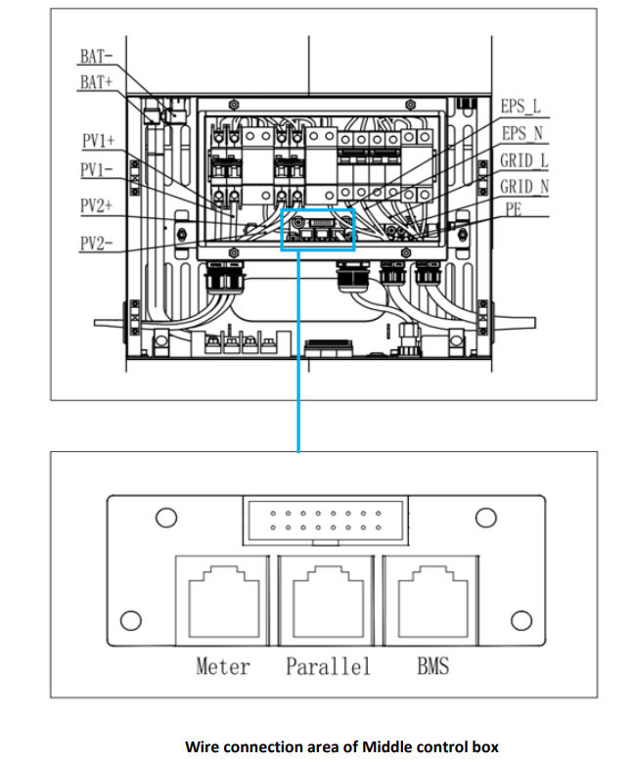
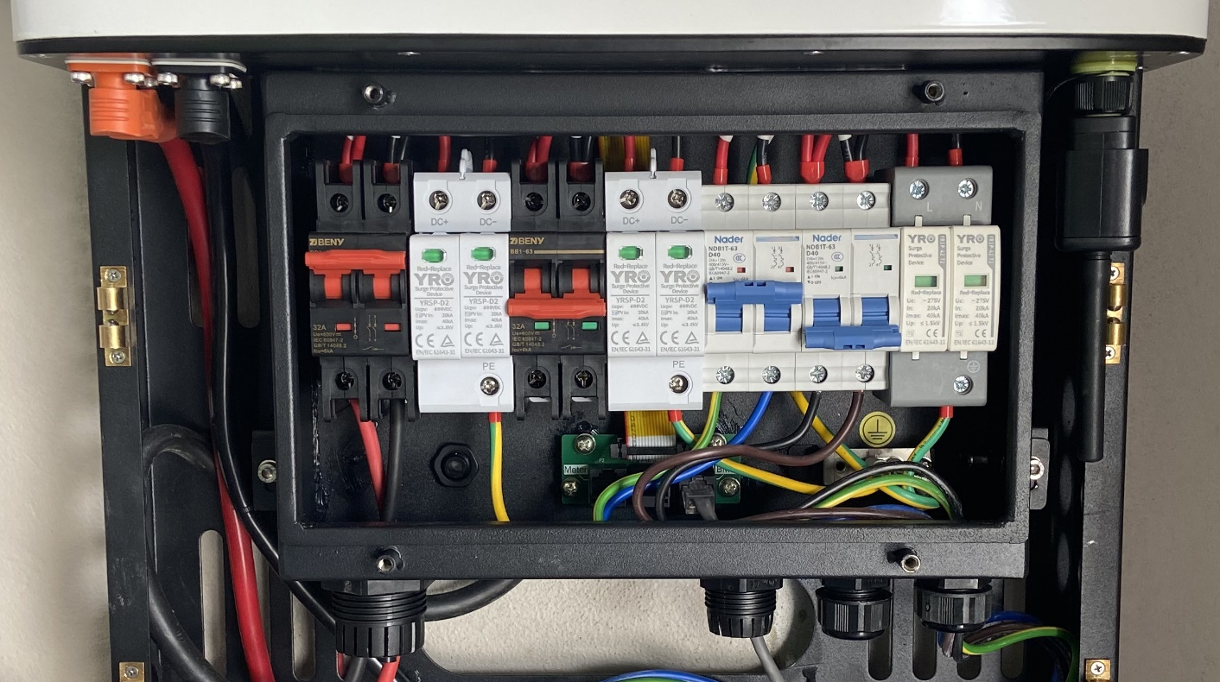
Overview Connection Area
PV1
PV2
EPS Breaker
Wi-Fi Port
AC Breaker
PV SPD
PV SPD
AC SPD
PE BAR
PV Port
COM Port
EPS Port
Grid Port

Slide 23
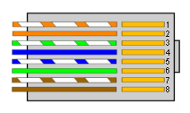
Smart Meter Connection
1. Normally the smart meter should be placed in or near the grid distribution box right after the billing meter.
2. Use the smart meter cable in the accessory box for communication.
Insert the RJ45 connector with water-proof cap into the port marked “Multi” on inverter and fasten the cap.
The wires on the other end should be stripped and connected to the smart meter accordingly.
If the cable length is not enough, please use the RJ45 extender in the accessary box to extend the cable.
1. METER_485B
2. METER_485A
3. GND
4. Reserved
5. Reserved
6. GND
7. Reserved
8. Reserved
Smart Meter Connector Pin Definition
The smart meter must installed in front of all loads, behind the grid input.

Slide 24
Procedure of Turn-on System
CAUTION: Before commissioning the inverter, make sure:
The country mark on the box is in accordance with the installation site;
The inverter is correctly and firmly mounted;
The Circuit breaker and RCD are correctly connected and are all in “off” position;
All cables are connected according to system wiring diagram;
Unused inputs must be sealed using the corresponding connectors or sealing plugs.
1. Power on the Grid
Wait for a while, the green led should be glowing and the graphical display should start displaying. Item “L”, “M”, “N”, should appear on the screen. If not, please power off and check for the connections of grid power line and smart meter.
2. Power on the Battery
The battery icon and its parameters should be shown on the screen. If the SOC of the battery is greater than 5%, the blue LEDs should also be turned on to indicate the SOC.
3. Power on the PV
If there’s sunlight, the PV icon and its parameters should be shown on the screen. Wait for a moment and the inverter will start a self-test procedure. When it is done successfully, the inverter will start using PV power to charge the battery or feed in power to the house and grid.
4. Switch on the loads
The load parameters should show.
5. Configure the Wi-Fi stick
Configure the Wi-Fi stick for remote monitoring.

Slide 25
Procedure of Turn-off System
Step1: Turn off the load;
Step 2: Turn off the PV;
Step 3: Turn off battery;
Step 4: Turn off the main grid switch;
Step 5: Wait for at least 5 minutes after the LED and graphical display black out for the internal circuits to discharges energy;
Step 6: Disconnect all the power cable;
Step 7: Disconnect all the communication cable, Remove the Wi-Fi stick;
Step 8: Remove the inverter from the wall, also remove the bracket if necessary;
Step 9: Pack the inverter with the original carton, and store it.

Slide 26
Export Power
Excess PV power is delivered to the Grid
When there is sunshine during the day, the electricity generated by the solar cell array is directly transmitted to the AC grid through the grid-connected inverter, or the electricity generated by the solar energy is directly supplied to the AC load （or charge battery） through the grid-connected inverter

Slide 27
Zero Feed-in
Zero feed-in means no excess PV power is delivered to the Grid.
The Zero Injection controller measures in real time the power flowing in the system and adjusts the set point of the solar system accordingly. In case of energy flow towards the grid, the Energy Injection controller will reduce the solar system.

Slide 28
Zero Feed-in
Zero feed-in means no excess PV power is delivered to the Grid.
The Zero Injection controller measures in real time the power flowing in the system and adjusts the set point of the solar system accordingly. In case of energy flow towards the grid, the Energy Injection controller will reduce the solar system.

Slide 29

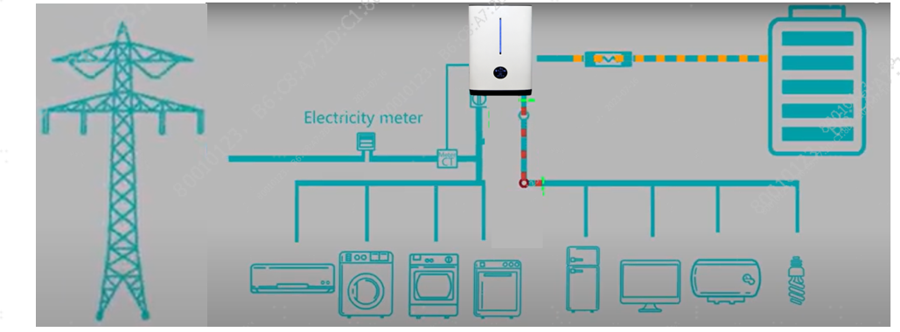
Back-up loads and On-grid loads
The output of the hybrid inverter has two ports,
one is the grid-connected port, which is connected to the grid-connected load,
the other is EPS port, which is the standby power port, which is connected to the standby load;
When the grid is normal, both loads are supplied power.
When grid is cut off, the grid-connected port stops outputing, and only the EPS port outputs to supply power to the standby load.

Slide 30
Notice: EPS Load
It is recommended to connect only household emergency loads such as lights, computers, refrigerators, etc. to the EPS port
Any load with a large impulsive starting current is not recommended to be connected to the EPS port, which is likely to cause the inverter to report a fault, such as water pumps, air conditioners, etc.（inductive loads）
It is not recommended to install RCD on EPS port

Slide 31
Notice: Battery
When using the battery for the first time, it is recommended to fully charge the battery
It is not recommend to install more than 2 GHybrid inverters in parallel
Multiple batteries are connected in parallel. It is recommended to connect the batteries in parallel after each battery is fully charged and the voltage gap between each other does not exceed 0.5V.

Slide 32
Quick Installation Guide for Parallel

Slide 33
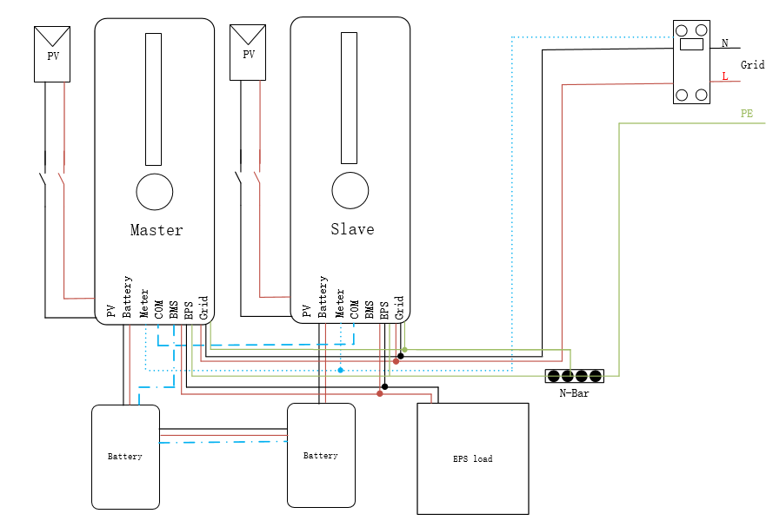

System Diagram
Parallel connection between 2 inverters
Connect different PV Panels separately
Grid power parallel (Grid)
Load power parallel (EPS)
Each inverter connected to the same smart meter separately
Connect a communication cable between 2 inverters through the COM port
Parallel connection between Inverters & Batteries
Connect the battery power cable between each battery and the inverter
Only the Master inverter needs to connect the BMS communication cable to the battery
Parallel connection between 2 batteries:
Another Power cables and Communication cable need to be connected between 2 batteries
No live operation!
It is forbidden to use PV or batteries to turn on the inverter during the wiring process!

Slide 34

Recommended Steps for Electrical Connection
After installing 2 ALL-IN-ONE Systems on the wall and finished their respective wiring
Step1: Step1: Choose a Location
Choose a wall capable of supporting the 2 full weight of system(>160kg)
Step 2: Anchor the Mounting-Bracket
Plan and measure distance between system components and determine cables length and distance
Step 3: Install the batteries
Hang battery on the wall, and connection battery cables between battery and inverter, and batteries
Step 4: Install the inverters
Hang the inverter and complete the wiring
Select the Master inverter and connect the BMS cable between battery and inverter
Connect the communication cable (COM) between Master inverter and slave inverter
Connect to PV Pannels separately
Connect the Grid to the meter input
Connect the 2 inverters to the output of the meter
Connect the meter communication cable between meter and 2 inverters
Connect the EPS output to the load power
COM Connection
BMS Cable
Power cables Connection
Master inverter
Slave inverter
No live operation
It is forbidden to turn on PV voltage and battery voltage before setting parallel connection

Slide 35
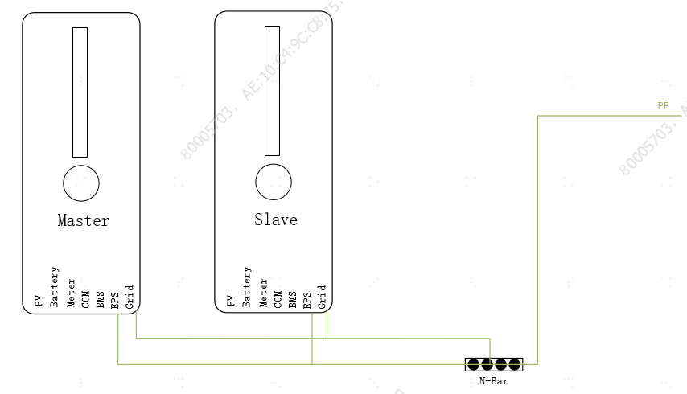
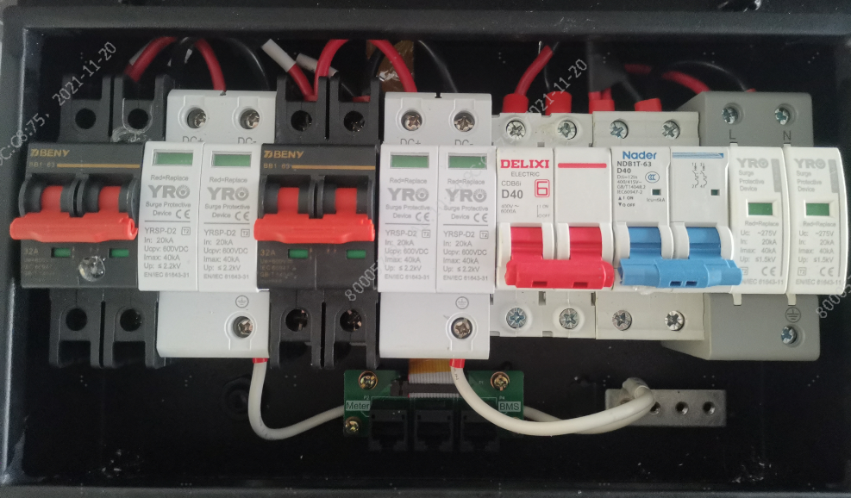
Notice: PE Connection
Please connect the ground cable first （PE）
Before connecting the electrical cables：
connect the ground copper bar of the Master and Slave to the ground cable to ensure normal grounding of the inverter and safety
Master
Slave
请在电气线路连接前，将Master & Slave的接地铜排与大地用接地线连接，以保证逆变器接地正常，确保安全

Slide 36
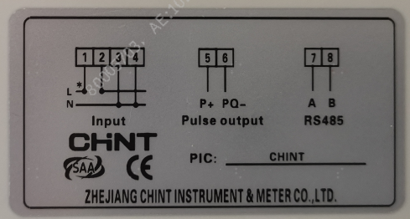
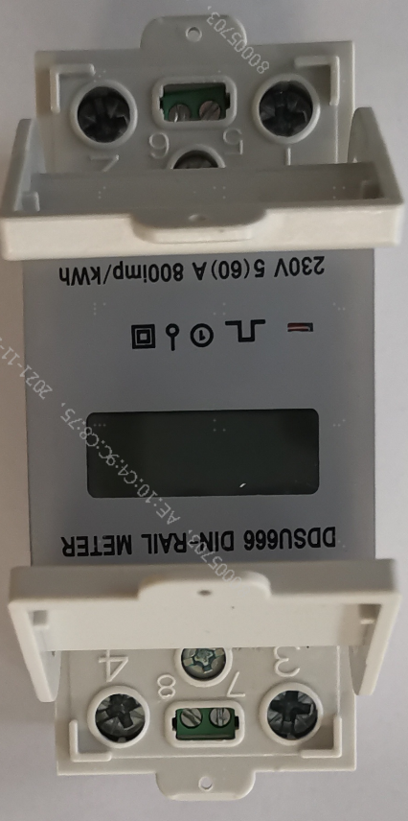
Notice: Smart Meter Connection
Electrical connection of electricity meter
Refer to the simple wiring diagram on the side of the meter
Port 1: Grid input LINE L
Port 2: Grid output LINE L
Port 3: Grid input LINE N
Port 4: Grid output LINE N
Grid Out-L to
Master Inverter
Grid In-L
Grid Out-L to
Slave Inverter
Master
Slave
Grid Out-N to
Slave Inverter
Grid Out-N to
Master Inverter
Grid In-N

Slide 37
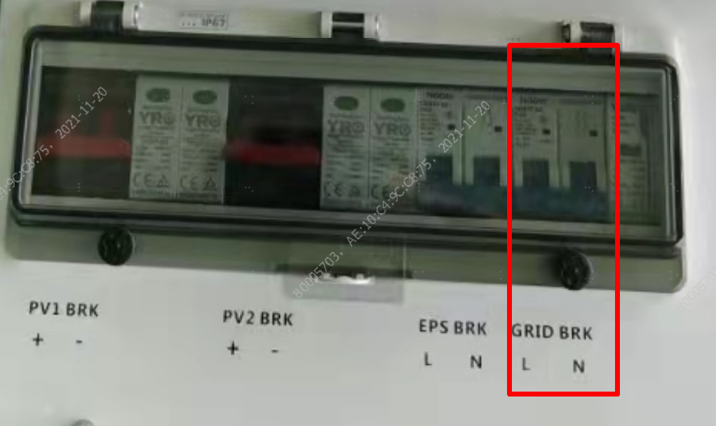
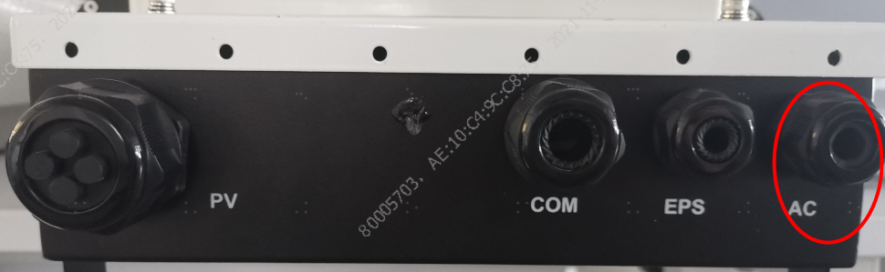
Notice: Grid Connection
Inverter Grid electrical connection
Master Grid
Slave Grid
Slave
Connect L/N two pairs of wires from the electricity meter respectively
Through the AC waterproof port
Connect wires at the corresponding L/N position of Grid BRK

Slide 38
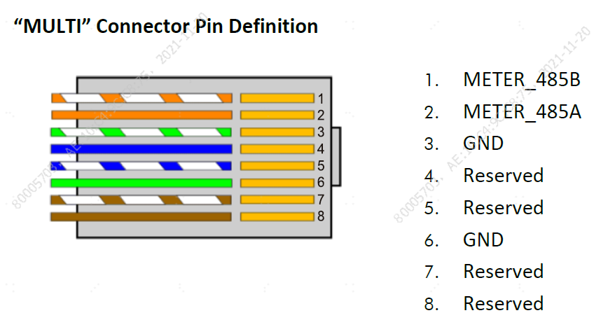
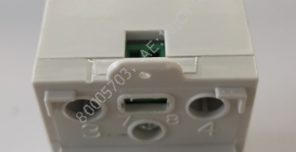
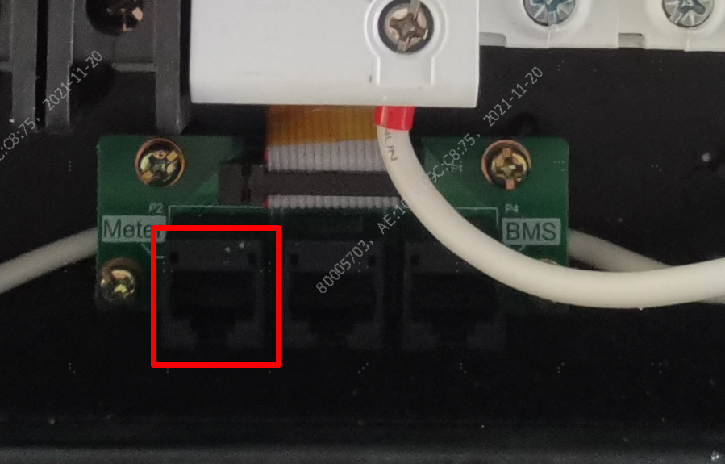
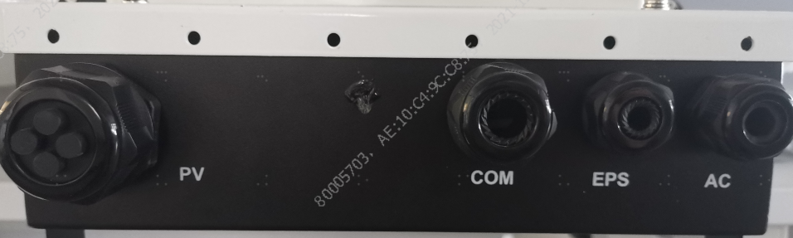
Notice: Meter Communication Cable Connection
Connect the Meter communication line to the two inverter Meter ports
485A
Port 7: meter 485A communication
Port 8: Meter 485B communication
485B
The communication line of the electricity meter needs two connections to the inverter Master and Slave
Master Meter
Slave Meter
The communication lines of the master and slave computers are inserted into the Meter port through the control box in the COM interface diagram

Slide 39
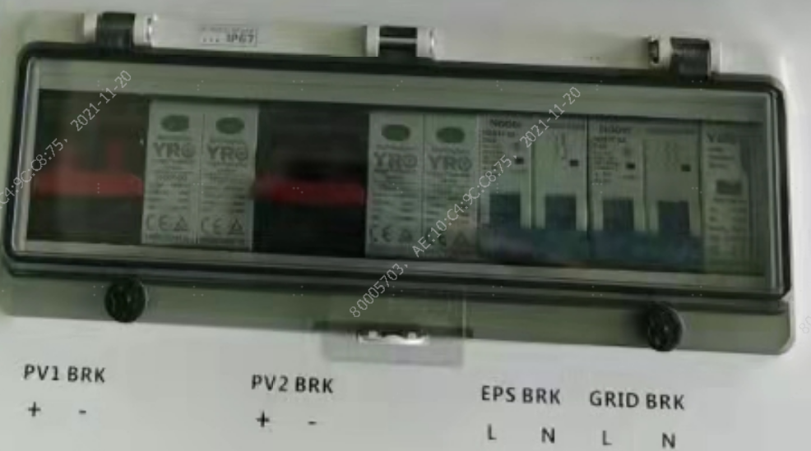
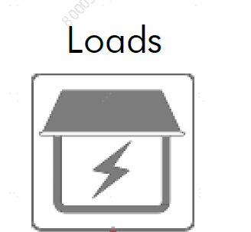
Notice: EPS Output
The EPS output port is connected in parallel to the load electrical end
Master EPS
Slave EPS
Connect L/N line from EPS BRK of main-slave machine
Waterproof terminals through EPS
Connect in parallel to household load

Slide 40
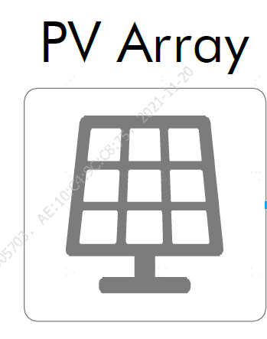
Notice: PV Connection
PV electrical wiring
Connect the PV module input cable to the PV BRK through the PV waterproof port
PV components cannot be connected in parallel
Master and Slave cannot be connected in parallel.
PV1 and PV2 cannot be connected in parallel.

Slide 41
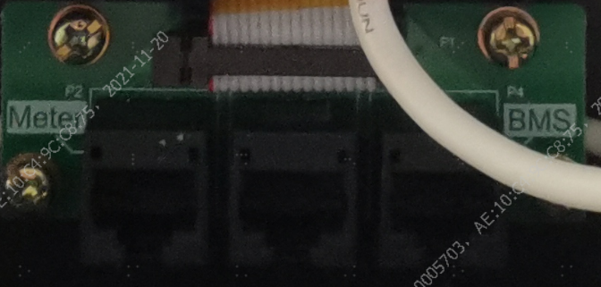
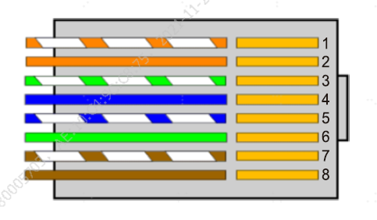
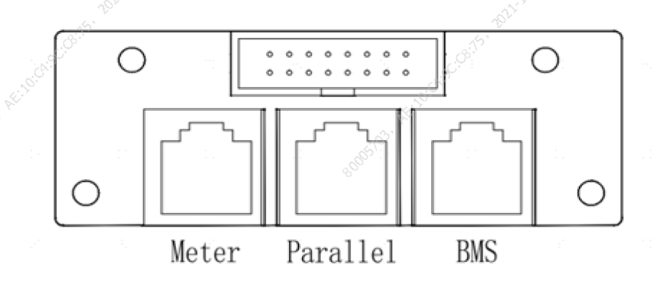
Notice: COM Connection between inverters
Host slave communication Line Connection (COM)
Pass the Master and Slave communication lines through the COM waterproof port to the inside of the central control box.
A Parallel port is inserted to enable the Master to communicate with the Slave

Slide 42
Notice: BMS Cable Connection
The battery communication cable is connected to the host BMS port
Only Master
Plug one end of the BMS communication cable into the COM UP port of the battery
The other end enters the interior of the central control box through the COM waterproof port of the host
Insert the Master BMS port

Slide 43
Notice: Battery Connection to Inverter
Connect the battery power cables to the corresponding inverters
STEP 1:
• Install the connectors to battery power ports; make sure the polarities are correct.
STEP 2:
•Plug the other ends of power cables into inverter. Please contact with your inverter vendor for detailed information.
GC-Solar parallel BMS communication line only requires Master connection
The Slave does not need to be connected
However, all battery power cables need to be connected

Slide 44
Notice: Parallel between 2 Batteries
Connect two batteries in parallel power line & communication line
STEP 1:
•Connect all the positive terminals of power ports of each battery.
•Connect all the negative terminals of power ports of each battery.
•Connect the power ports to inverter.
STEP 2:
•Connect the BMS ports of each battery. The COM DOWN should be connected to the COM UP.
Master Battery
Slave Battery

Slide 45
Notice: Wi-Fi stick Connection
Step 1:
• Peel off the tape that covers the EMS port
Step 2:
• Insert the Wi-Fi stick into the Wi-Fi port and screw it tightly
Step 3:
• Wi-Fi stick implements communication with Cloud server through wireless network to monitor PV inverter's data status. For more details, refer to WIFI Product Application Manual.
Master Inverter
Slave Inverter

Slide 46


